Slide 1
Grainger Renewals Journey
There’s always a better way

Slide 2


Overview
Grainger Renewals Project
Grainger plc have engaged with Open Box to redesign the existing Renewals Journey in their Salesforce org.
​​The renewals process is currently shoehorned into the Salesforce leasing journey, designed primarily for new leases. Many key inputs for this process are held out of system (including price book rent in spreadsheets) or in other systems (such as arrears balances in Qube), requiring considerable manual effort to cross-check information between systems and key into offline spreadsheets that are circulated between teams. Limitations with the existing portal in which tenants review renewal offers, result in tenants being regularly unable to access the portal.
The likely introduction of the Renters’ Rights Bill in 2025 must additionally be considered as this will have a notable impact on the renewal process for the majority of Grainger tenants.

Slide 3
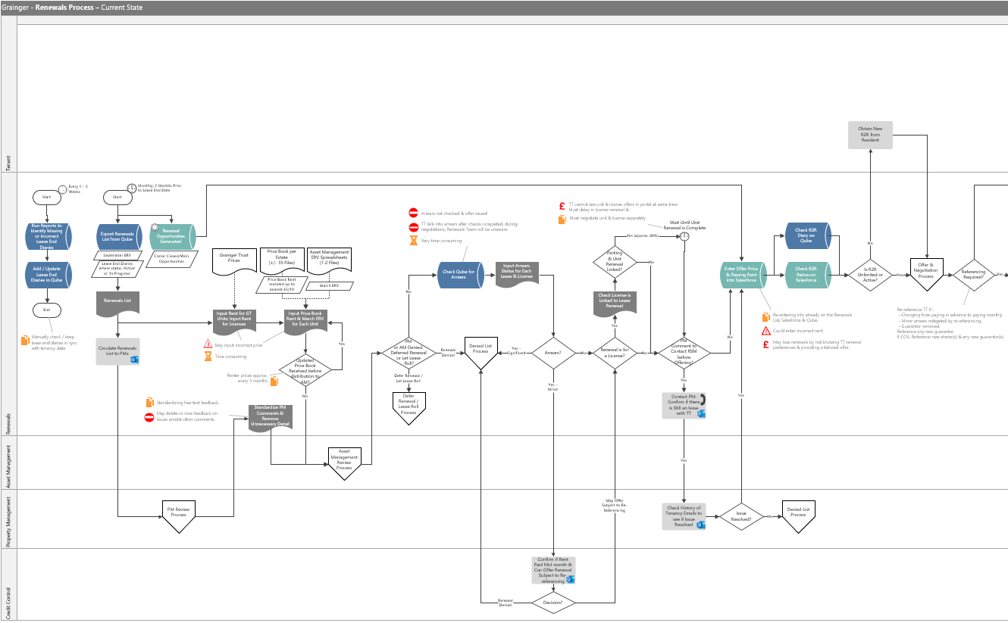
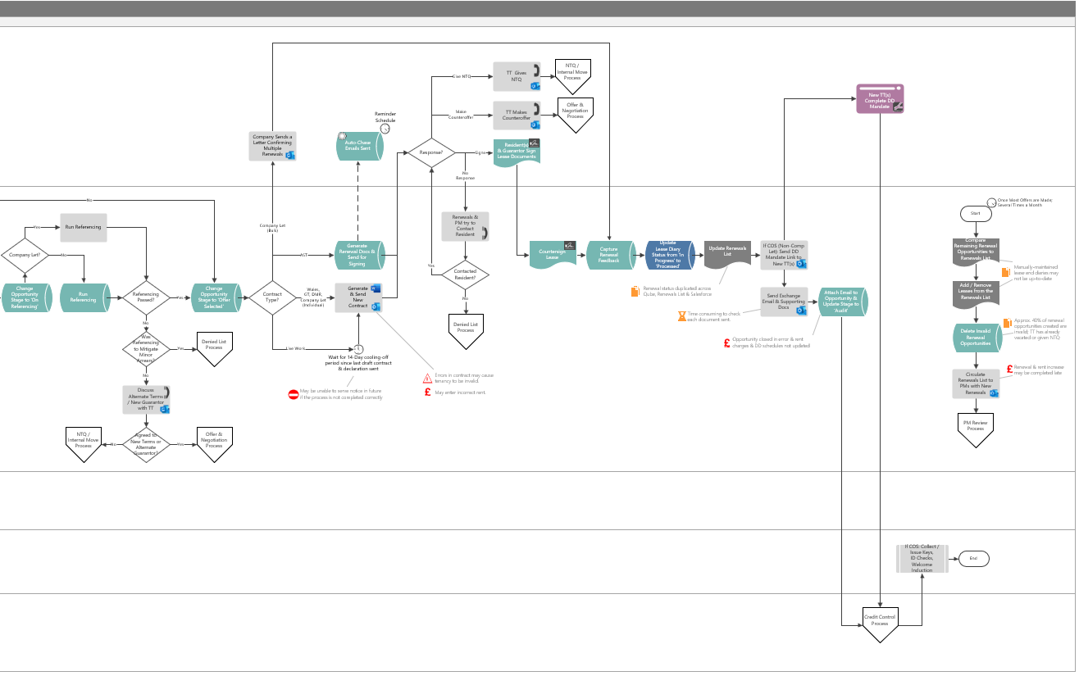
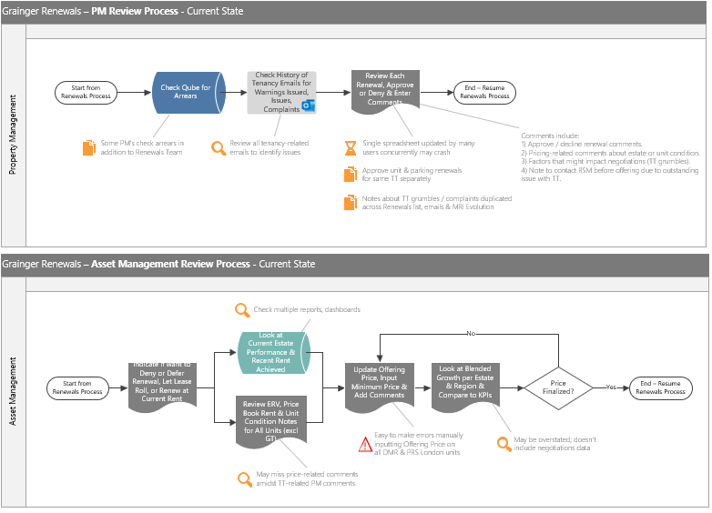
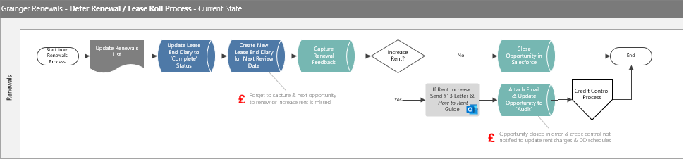
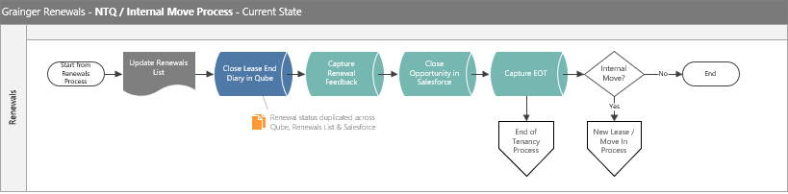
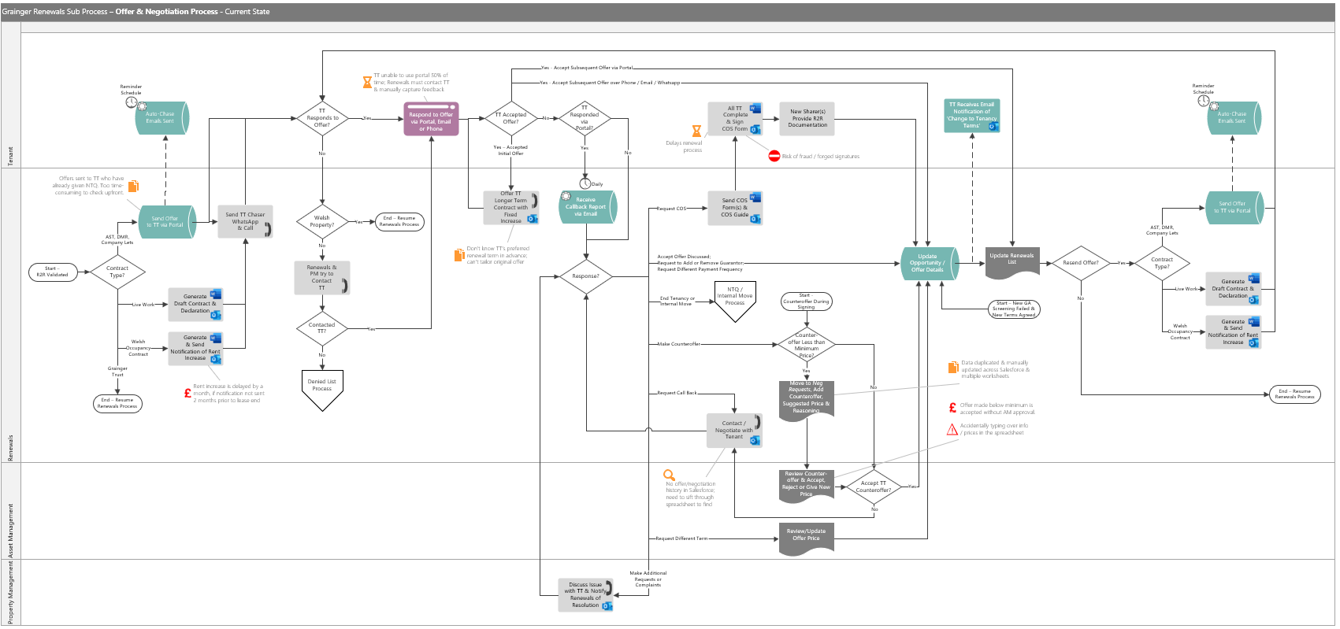
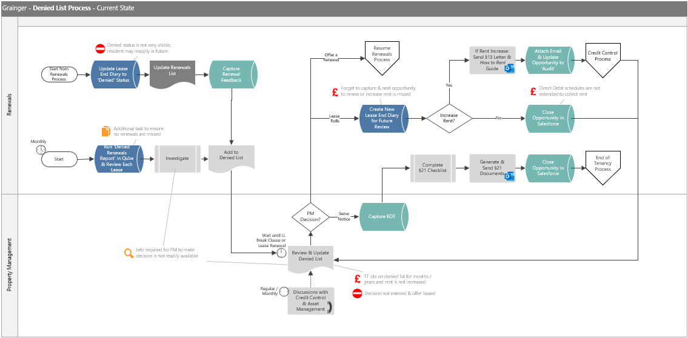
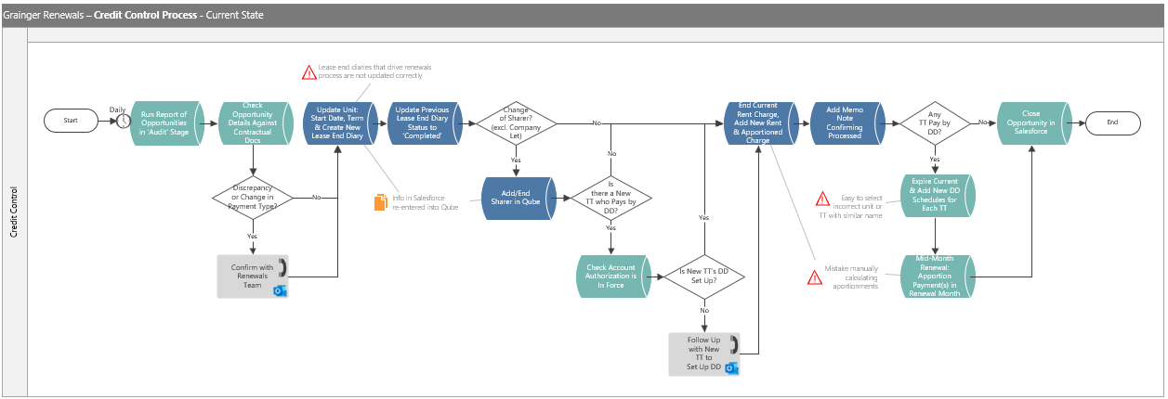
Current State Process Flow
Significant Inefficiencies, Risks & Off-System Processes

Slide 4

Current Risks & Challenges
Risk of Monetary Loss
Time-Consuming Tasks
Risk of Errors from Significant Manual Data Entry
NTQ received late.
Lease end diary not captured / incorrect.
Delayed rent increases for Wales must wait a further month.
Tenant sits on denied list for years & rent is not increased.
Duplicate data entry across Qube, spreadsheets and Salesforce.
40% of renewal opportunities created in Salesforce are incorrect.
Tenants unable to use renewal portal 50% of the time & contact staff directly.
Inputting incorrect prices.
Accidentally overwriting or deleting information on the spreadsheet
Risk of Renewing Tenancies that should be Denied
Lack of Visibility & Easily Accessible Information
Limited Controls
Tenant falls into arrears after checks.
Renewals not aware of decision to serve notice.
PM comments are deleted in error when unstructured feedback is cleaned-up.
No history of offers, counteroffers and tenant responses hinders negotiations and decision-making.
Arrears checks are missed in error.
AM approval for offers below minimum price is skipped in error.
Current Challenges with the Renewals Process:
Risk of Errors from Significant Manual Data Entry
Duplicate Data Entry across Salesforce, Qube & Spreadsheets
Lack of Visibility Hinders Decision-Making
Risk of Renewing Tenancies that Should be Denied
Delayed Renewals Result in Monetary Loss
Time-Consuming Tasks
Notes:
Limited to risks & inefficiencies that we believe we can address in R1

Slide 5

Vision & Objectives
Project Vision :
Replace the existing tenant portal for renewal offers as well as the offline renewal spreadsheets with an enhanced Salesforce Renewals Journey that minimises manual data entry, removes the need to cross-check information between Salesforce and Qube, and delivers functionality that will remain relevant once the Renters’ Rights Bill is enacted.
Key Objectives :
Deliver Functionality Relevant for Renter’s Rights
Replace Offline Renewals Spreadsheet
Eliminate Manual Input of Price Book Rent & ERVs
Provide Visibility into Tenancy Arrears in Salesforce
Create Renewal Opportunities from Accurate Tenancy Data
Maintain Offer & Counteroffer History

Slide 6
Business Benefit
Redesigning the Renewals Journey will help to:
Obtain notice to quit from tenants earlier in the process, minimising void days.
Highlight renewals approaching deadlines to avoid delayed rent increases.
Allow business to scale operations without necessitating a linear increase in headcount
Build the foundation for a single view of customer within Salesforce.
Improve speed & efficiency of the process.
Obtain renewal preferences from tenants upfront, allowing for renewal offers to be tailored.
Minimise back-and-forth between tenants and renewals negotiators.
Improve the tenant experience with a reliable online interface.
Reduce offline communications between teams.
Provide a single source of truth for renewal information.
Minimise errors.

Slide 7
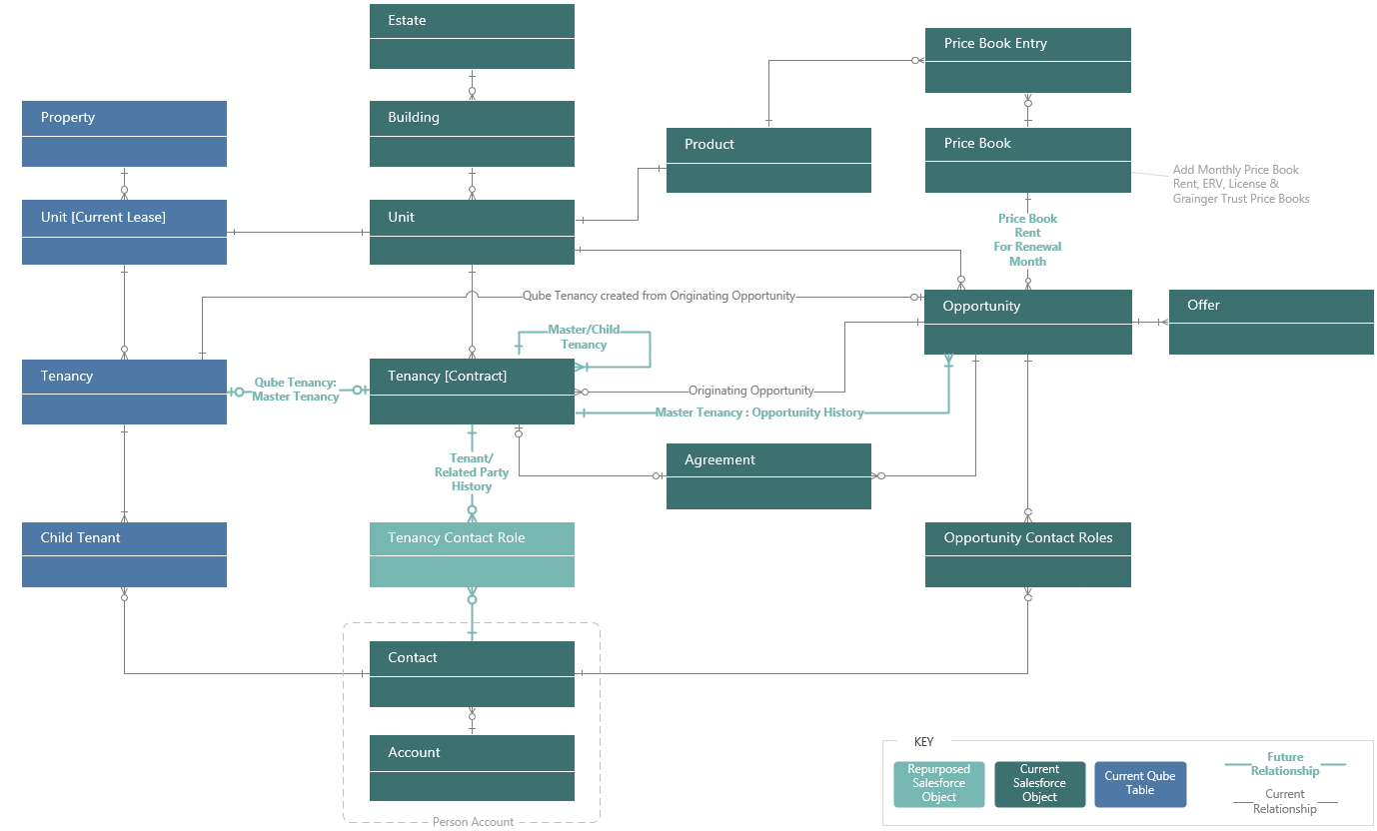
Solution Features – Release 1
Create Foundation for a Single View of Customer
Align Qube & Salesforce Tenancy Data Model

Slide 8
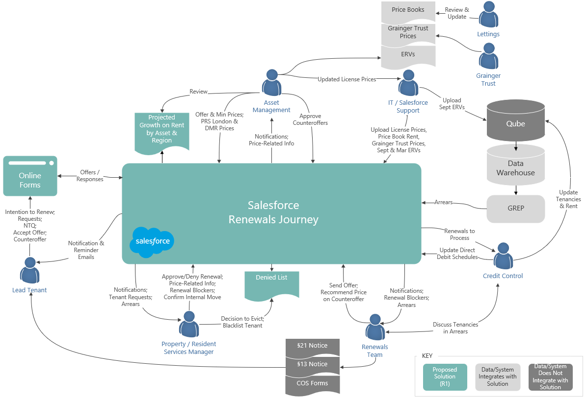
Solution Features – Release 1
Prepopulate Inputs to the Renewals Process
See Current
Tenancy Arrears in Salesforce
Upload ERVs, Price Book Rent, Grainger Trust & License Prices
Deny a Renewal
Mid-Term &
Manage Denied List
Manage Unit Condition & Estate Pricing Factors
See Projected
Growth on Rent
by Asset & Region
Manage Tenant
Requests at Renewal &
Renewal Blockers

Slide 9
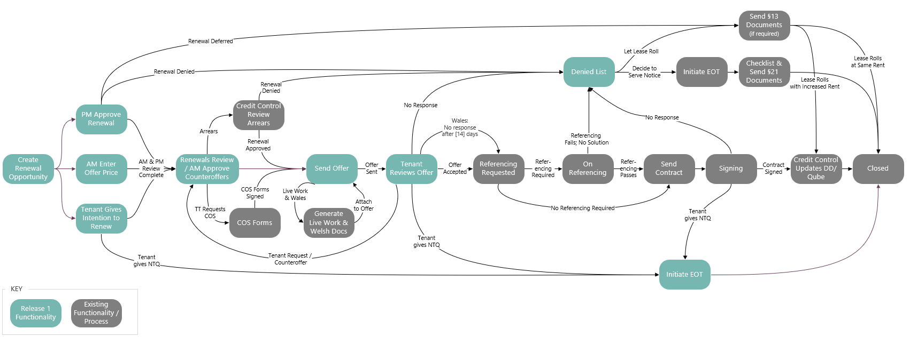
Solution Features – Release 1
Replace Spreadsheet & Tenant Portal within the Current Renewals Journey
Automatically Create Renewal Opportunities from Accurate Tenancy Data
Enable Tenant to give
Early Intention to
Vacate or Renew
PMs Approve, Deny, or Defer Renewals
AM Update
Offer & Minimum Prices
Renewals Team Review & Send Prepopulated Offers; See Full Offer History
Tenants Receive, Respond to Offer(s) & Counteroffer Online
AM Approve Counteroffers
Initiate EOT when
Tenant gives NTQ or
for Internal Move

Slide 10
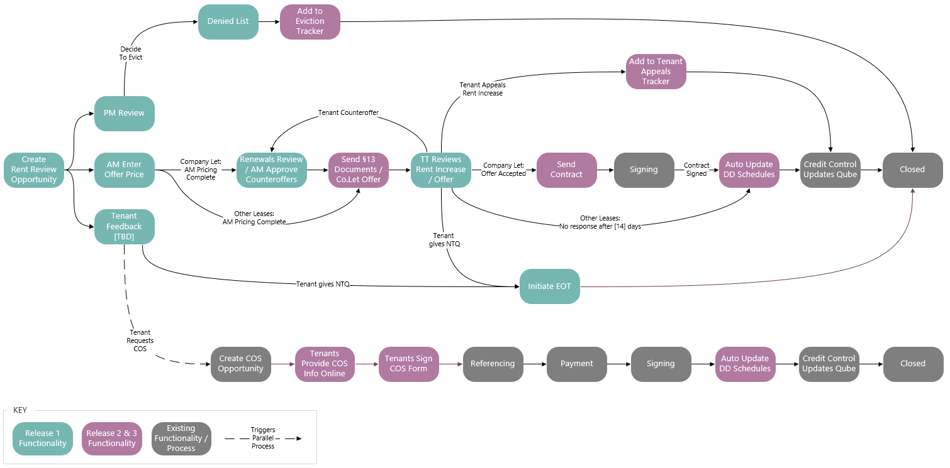
Solution Vision - Post-Renters’ Rights Bill
Build on the Enhanced Renewals Journey

Slide 11

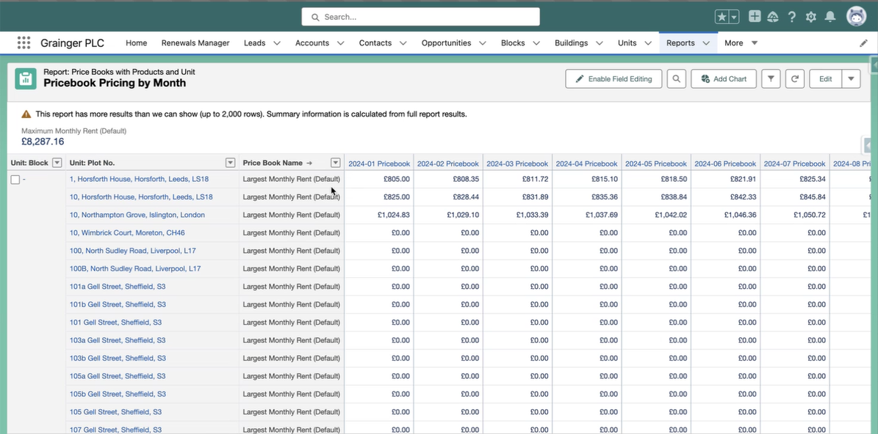
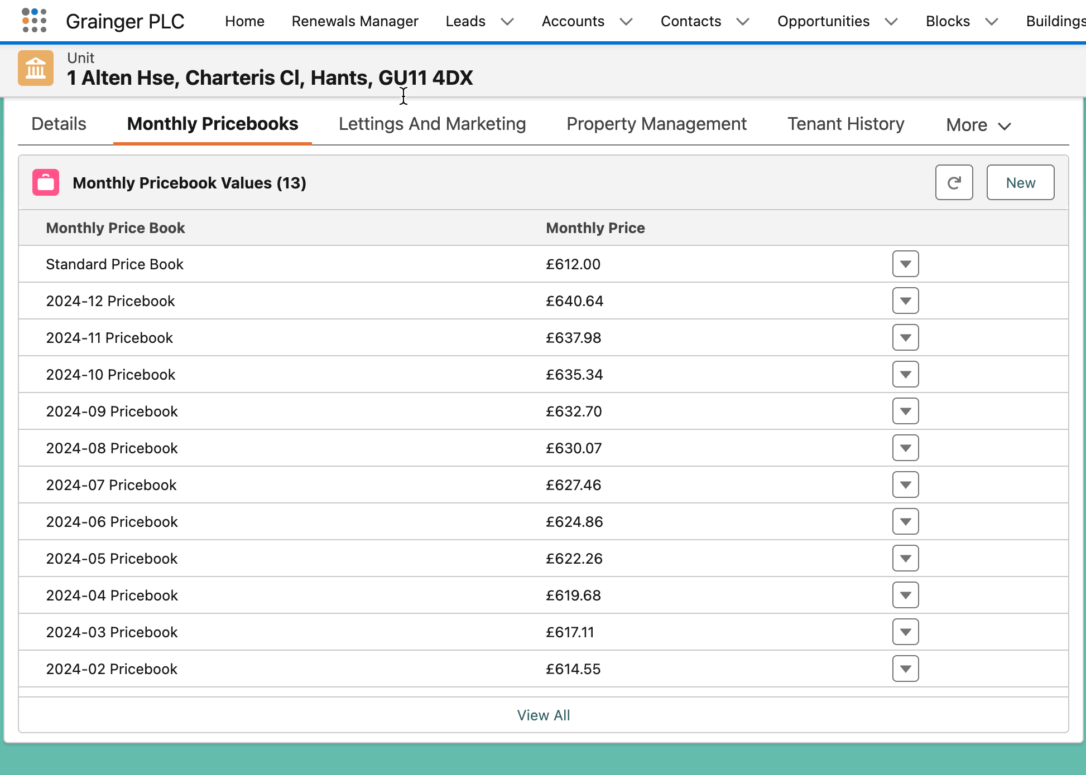
Proof of Concept
Storing Price Books in Salesforce
Use standard Salesforce Pricebook objects to store price book values, ERVs, Grainger Trust & license prices.
Price Book entries for the renewal month can be used in the renewal process
View historical & future price book values for a unit

Slide 12
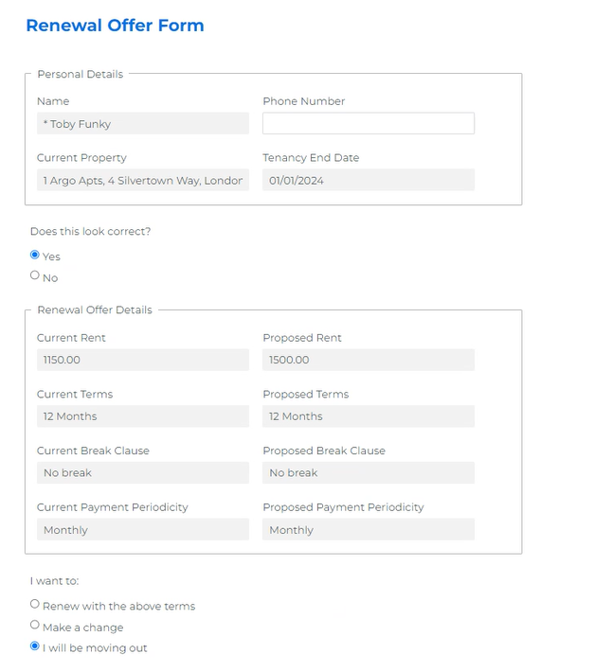
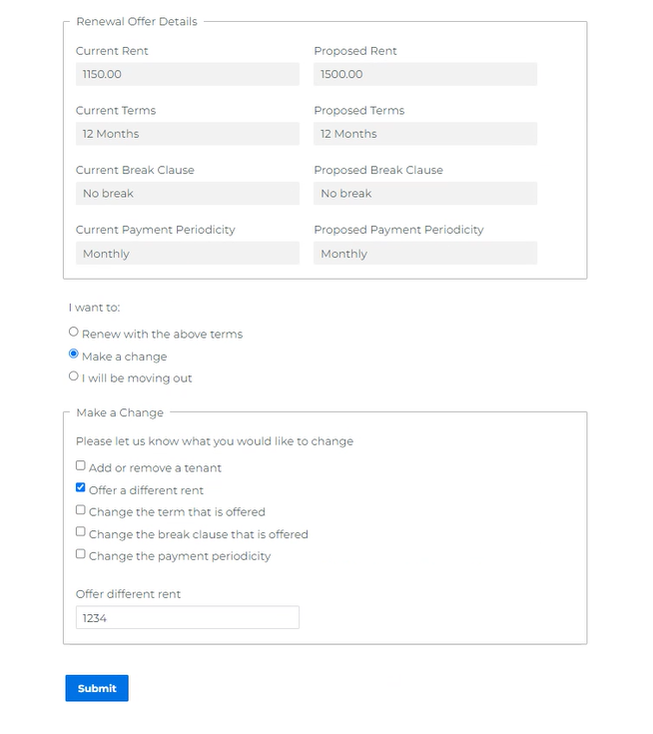
Proof of Concept
Tenant Provides Renewal Intention or Responds to Offer via Form Assembly
Dynamic form prompts tenant for more information depending on response(s) selected
Tenant clicks on link in a system-generated email to open a form
Opportunity & offer information is sourced real-time
Reponses are saved on the opportunity, offer or create new records

Slide 13
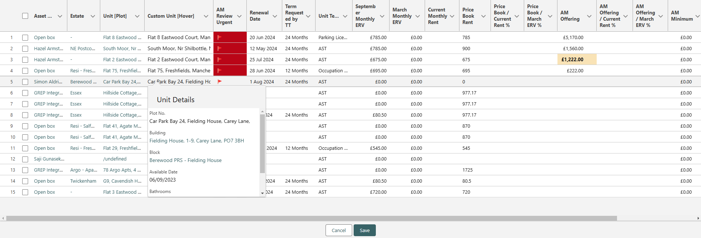
Proof of Concept
Replace Renewals Spreadsheet with LWC Data Tables Relevant for each Team
Create tables for each team displaying renewal opportunities & information relevant to them
Conditional Formatting
Information can be sourced from related objects e.g., latest price book rent for the renewal month
View information about the opportunity or related objects in a hover over

Slide 14
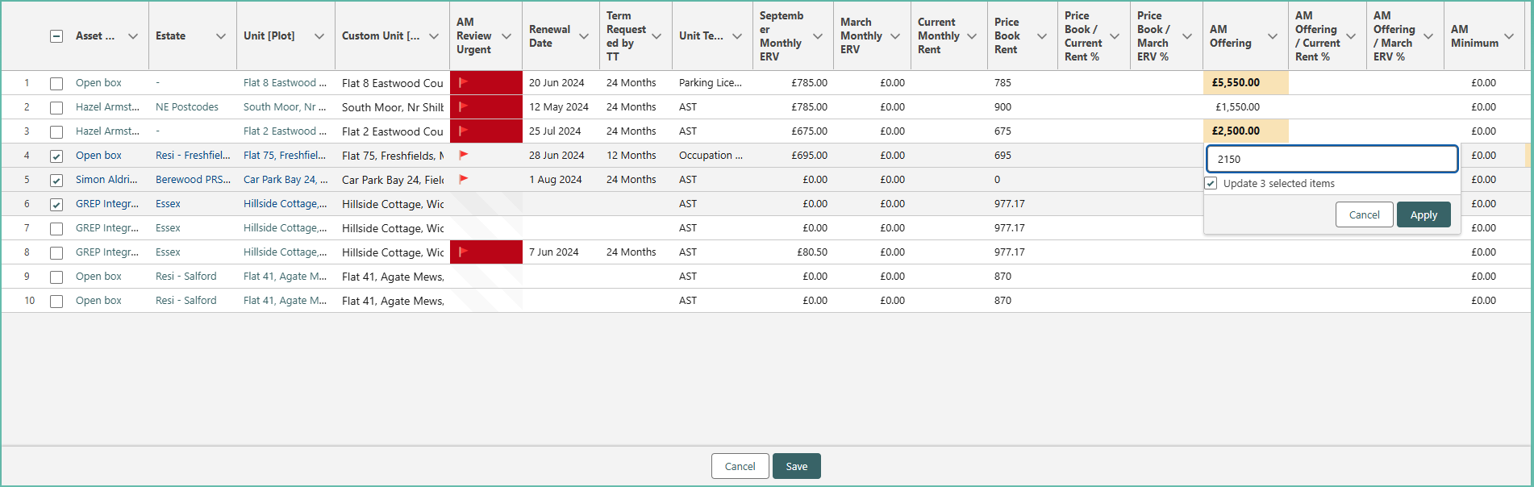
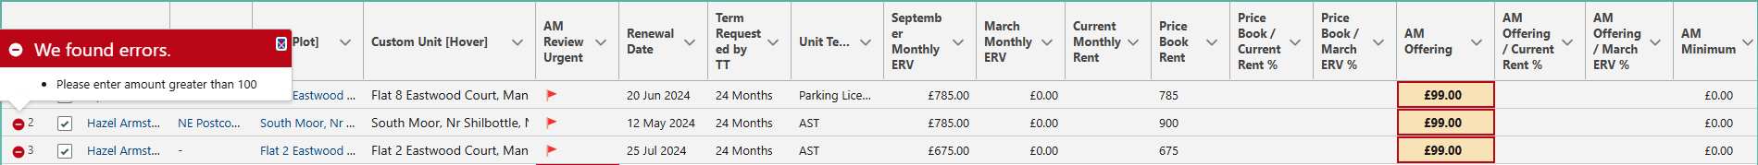
Proof of Concept
Replace Renewals Spreadsheet with LWC Data Tables Relevant for each Team
Users can make bulk updates
Additional functionality available:
Filters
Calculated fields
Action buttons
Values that fail validation are highlighted

Slide 15
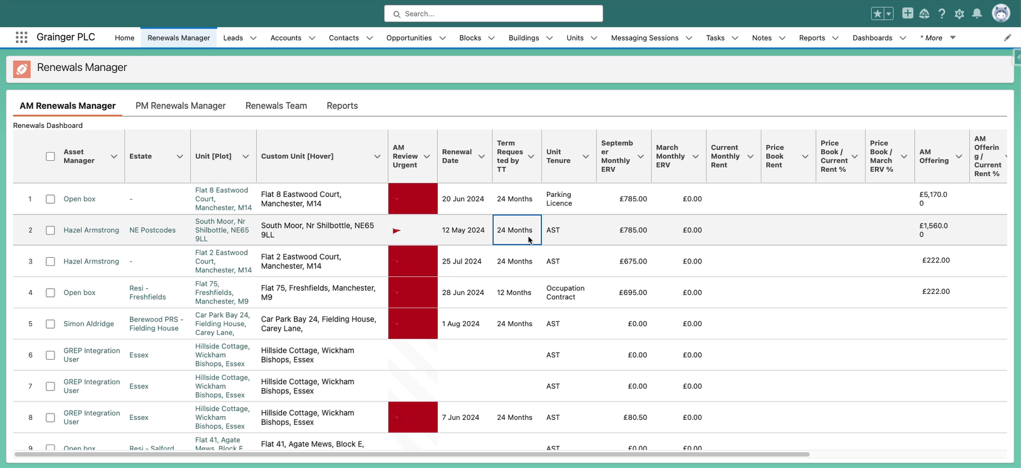
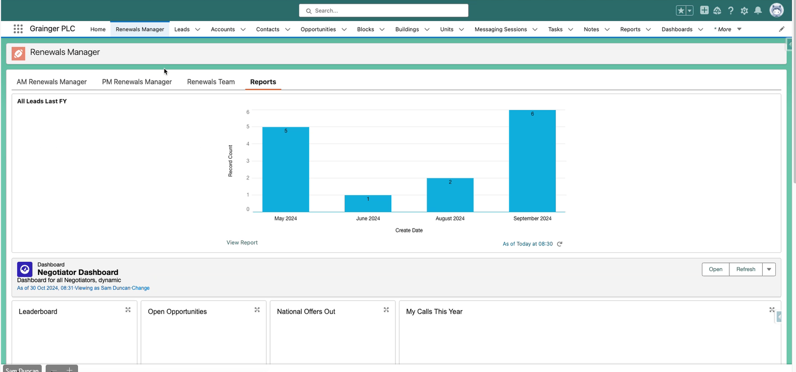
Proof of Concept
Renewals Manager Consolidates Team Lists & Dashboards
Display lists for each team
Display new Projected Growth on Rent report as well as existing dashboards used by Asset Management on a single screen

Slide 16
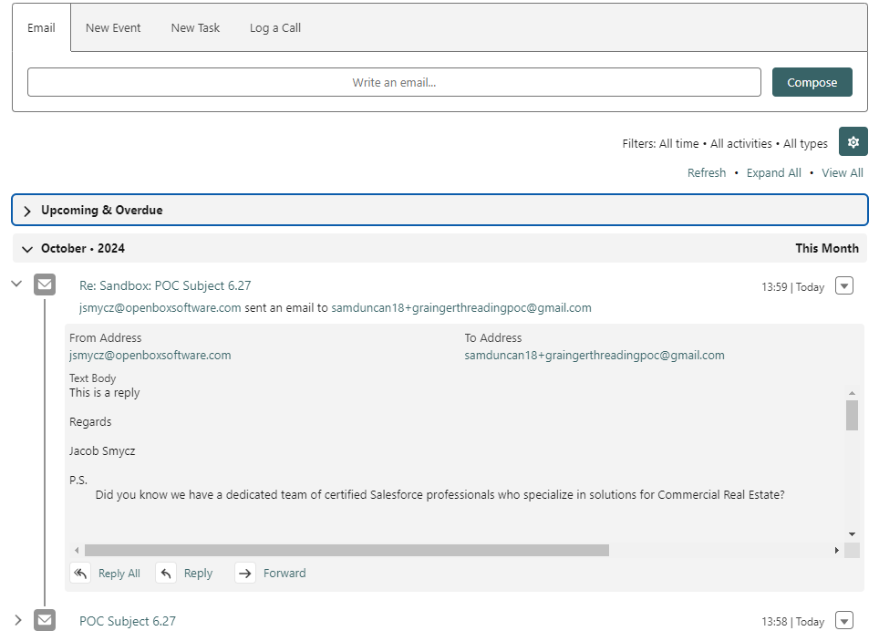
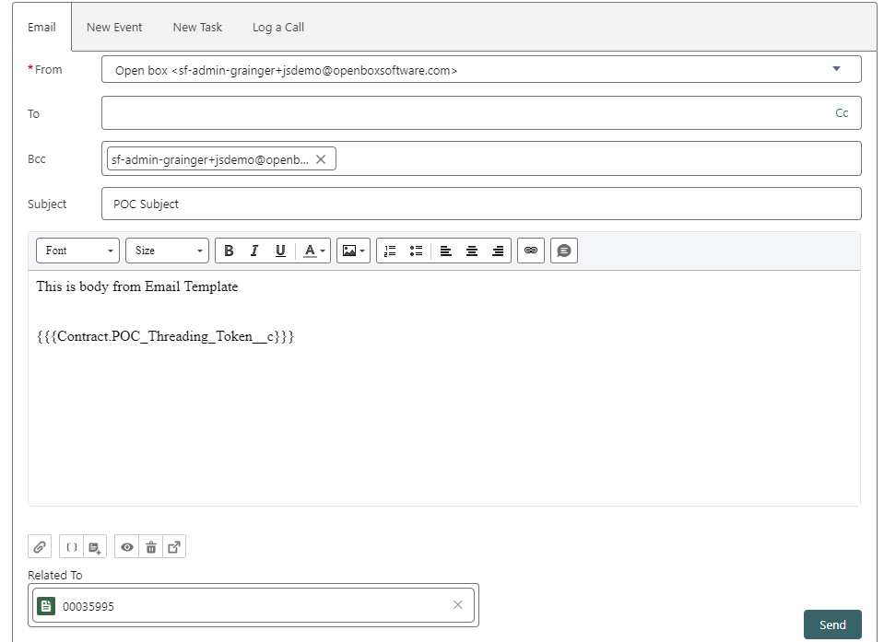
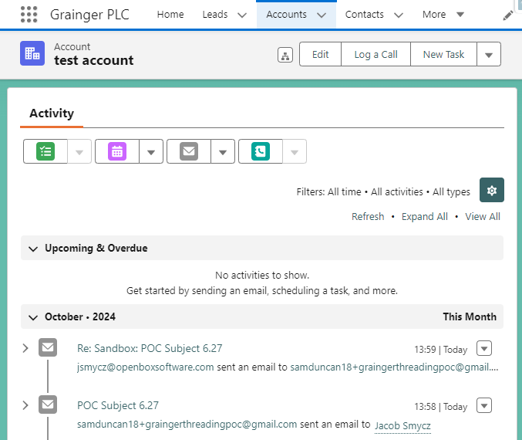
Proof of Concept
Email response is displayed on the opportunity
Email Threading onto an Opportunity
User sends an ad hoc email to the tenant from an opportunity, selecting an email template that includes a threading token
Email response
is also displayed on the tenant (person account)

Slide 17
Proposed Roadmap
Release 1
Release 2
Post Renters’ Rights Bill
Release 3 Future
Denied List
Tenant Gives Early Intention to Renew
PMs Approve, Deny, Defer Renewals
Manage Renewal Requests & Blockers
View Unit Condition & Estate Pricing Factors
Upload ERVs, Price Book Rent, Grainger Trust & License Prices
AM Update Offer & Minimum Price
Projected Growth on Rent Report
View Tenancy Arrears
Tenants Respond to Offers Online
AM Approve Counteroffers
Initiate EOT at NTQ or Internal Move
Align Qube & SF Tenancy Data Model
Generate §13 Notification of Rent Increase
Rent Appeals Tracker
Eviction Tracker
Customise Renewals for Wales, Company Lets, Live/Work, DMR & Grainger Trust
AM Dashboard: Comparable Rent & Performance by Estate
PM/RSM Visibility into Rent Increases
Omni-Channel Communications & WhatsApp Integration
Online Change of Sharer Forms
Update Direct Debit Payment Schedules
Bulk Negotiation for Company Lets
Manage Price Book Rent in Salesforce
Single View of Tenancy Incidents, Complaints, Grumbles & Survey Feedback
Update Tenancy & Rent in Qube on Renewal
2024 2025
15 Nov
Early May
Notes:
5 Sprints: Go live = 25 April
6 Sprints: Go live = 16 May

Slide 18
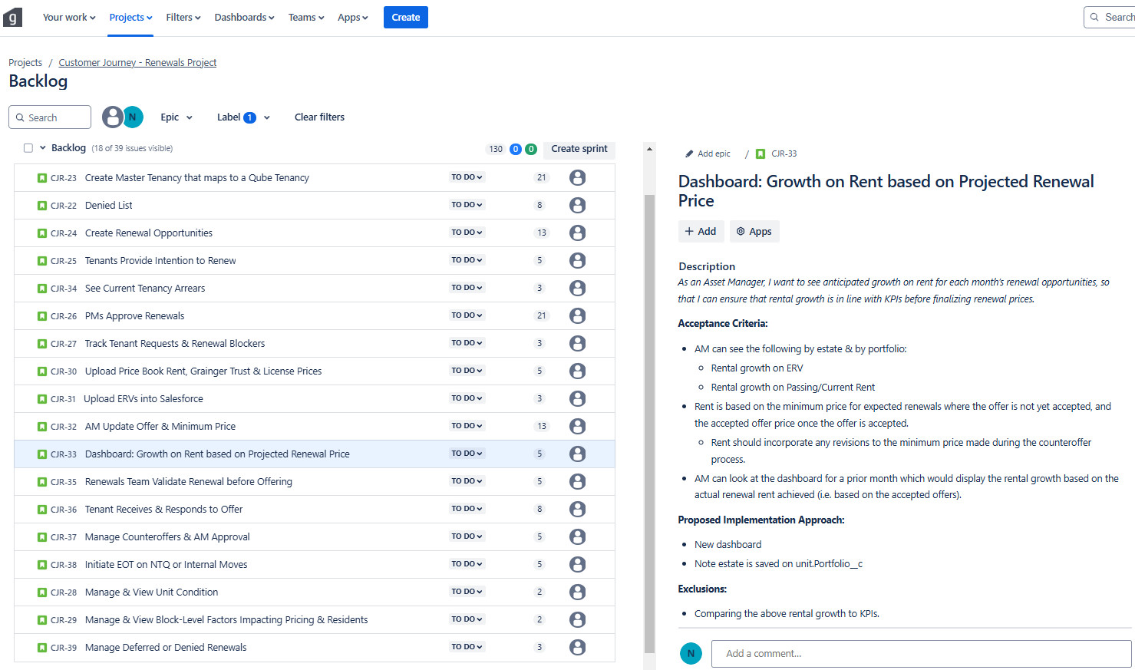
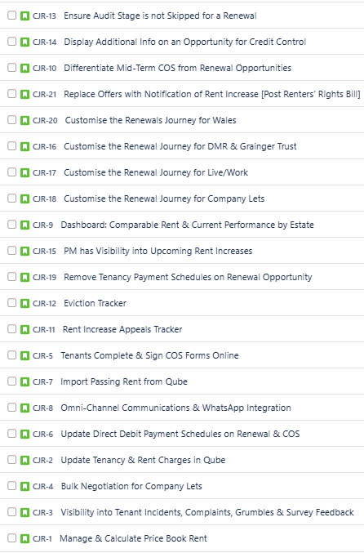
Feature Backlog
18 Features Addressed in Release 1 & 21 Remaining Features/Projects

Slide 19
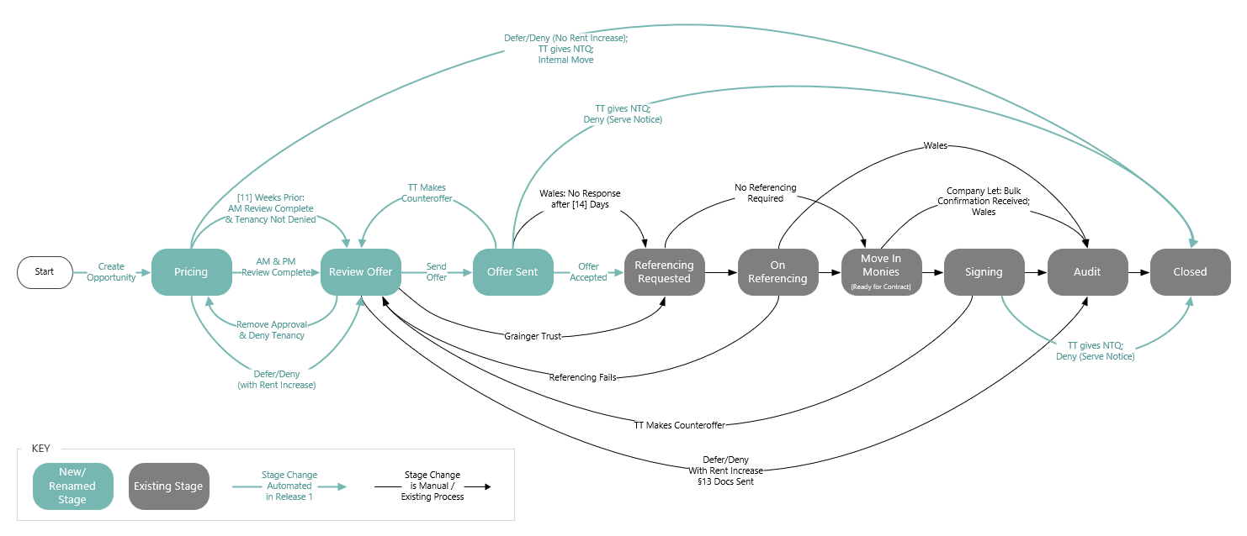
Proposed Renewal Opportunity Stages
Reimagining the Renewal Journey Up Until Offer Acceptance

Slide 20
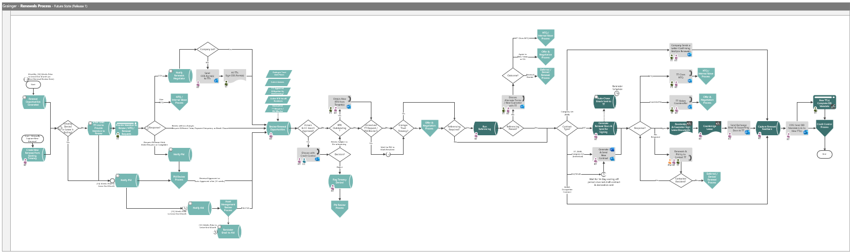
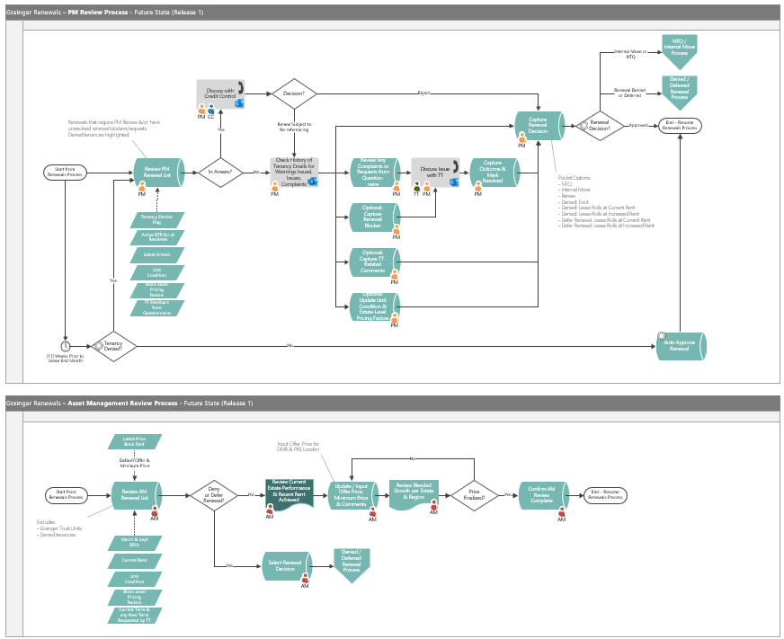
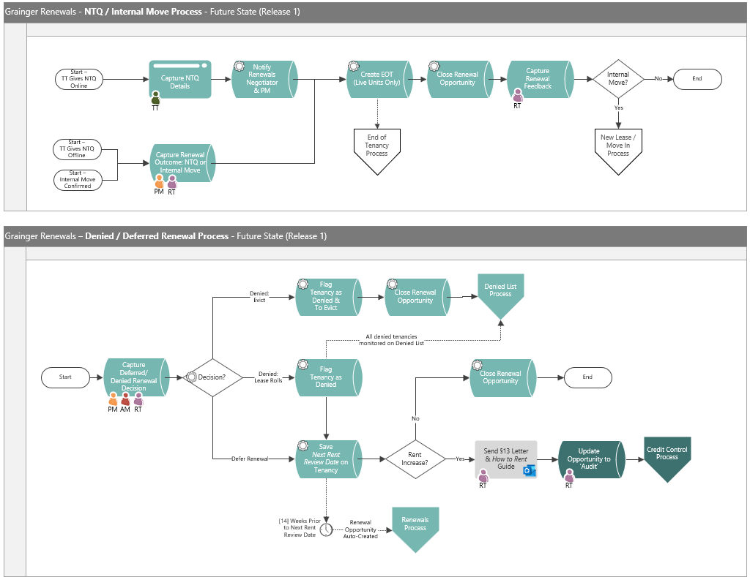
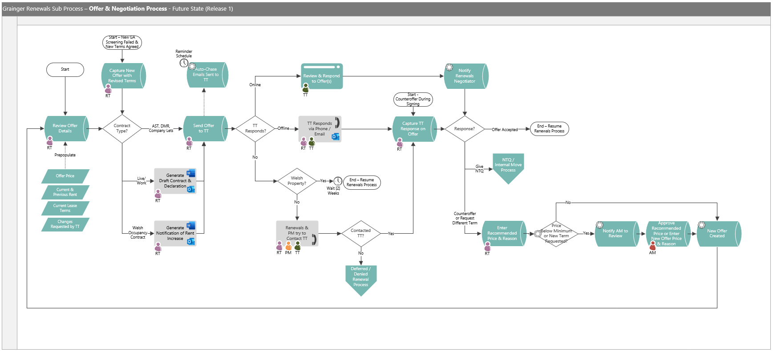
Proposed Future-State Process

Slide 21



Agile Delivery Approach
Iterative delivery is achieved through a series of 3-week sprints
Process Improvement
Sprint Retrospective
Open Box Activity
Grainger Activity
Joint Activity
Daily Stand-up
3-week Sprint
Sprint Planning
Sprint Demo
Testing
Product Increment
Sprint Backlog
Product Backlog
Backlog Refinement & Prioritisation
Backlog Refinement
Feedback

Slide 22
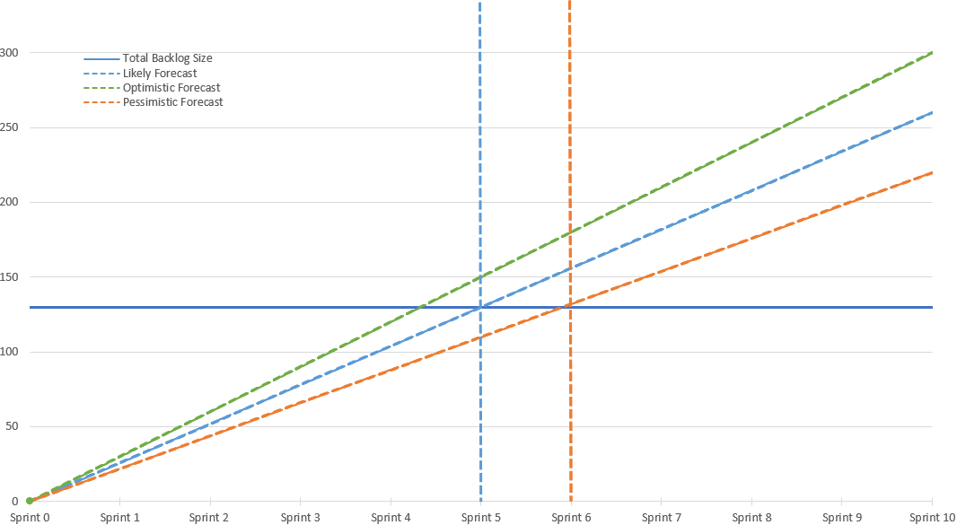
Release 1 Forecast
Likely: 5 – 6 sprints

Slide 23




Project Team & Forecasted Costs
Open Box Delivery Team
Salesforce Architect
Business Analyst
Developers
Quality Assurance
Project Manager
1 Sprint
Release 1
420
5-6 sprints
hours
effort
3
5½-6 months
GRAINGER Delivery Team
Product Owner - Main point of contact
weeks
duration
£40 950
£222 795 – £259 650
Subject Matter Experts Project Sponsor - Involved in Demos & UAT
Change Management & End User Training Specialist
cost
total cost
Notes:
assumes 4 weeks UAT

Slide 24
Dependencies
Grainger to add daily integration to import tenancy arrears from the data warehouse or Qube into Salesforce.
Note imports from Qube would be additionally dependent on MRI enhancing the Qube web service.
Functionality to identify DMR and affordable rent units in Salesforce (currently in scope for the Grainger Trust project).

Slide 25
Next Steps
Open Box to deliver a detailed Proposal Document to deliver the first release of Renewals enhancements.
Grainger to sign the proposal to move forward.

Slide 26

Thank You

